Slide 1

Test-driven development
Python | Django | Selenium

Slide 2


What is TDD?
Python | Django | Selenium

Slide 3
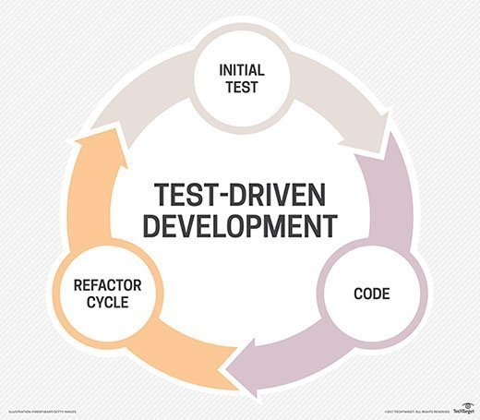

Slide 4
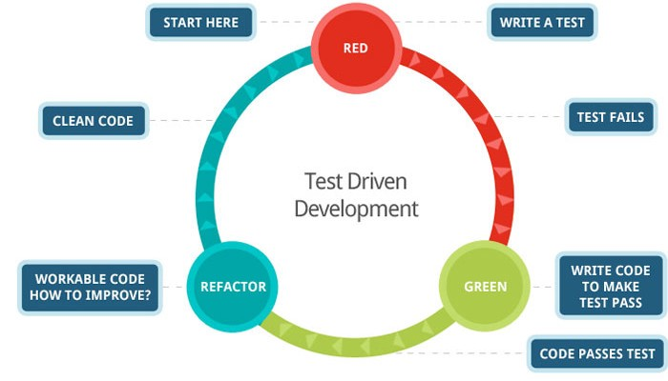

Slide 5
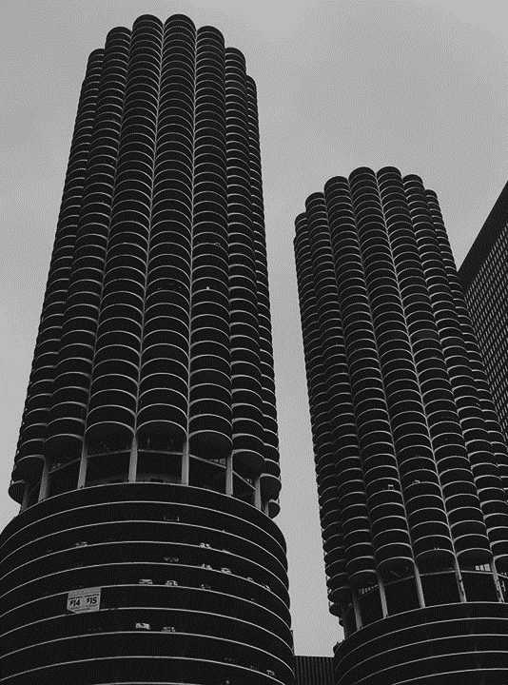
“Test-driven development” refers to a style of programming in which three activities are tightly interwoven: coding, testing (in the form of writing unit tests) and design (in the form of refactoring).
It can be succinctly described by the following set of rules:
Write a “single” unit test describing an aspect of the program.
Run the test, which should fail because the program lacks that feature
Write “just enough” code, the simplest possible, to make the test pass
“Refactor” the code until it conforms to the simplicity criteria
Repeat, “accumulating” unit tests over time
-agilealliance.org

Slide 6
Test-Driven Development is simply writing the test(s) before writing the code for the product

Slide 7
Why bother?
Python | Django | Selenium

Slide 8
Main Strengths
Forces us to make a visual and runnable validation first before writing the product.
It generally created a set of rules that multiple developers can check and follow.
It allows the developer(s) to have a matrix for what to accomplish.
It allows shipping out of product alongside unit tests immediately after production
It forces us to write “testable” and “maintainable” codes
Reductions in defect rates, at the cost of a moderate increase in initial development effort
Work in smaller, safer, better understood steps
It allows repeatable tests for requirements re-checking before and after coding, and before and after refactoring.

Slide 9

When Should we Test?

Slide 10
ALL THE TIME
Before writing code, during writing code, after writing code, when revisiting code, checking others’ code, before rollout, after rollout, and whenever in doubt.

Slide 11
TDD and AGILE
Python | Django | Selenium

Slide 12
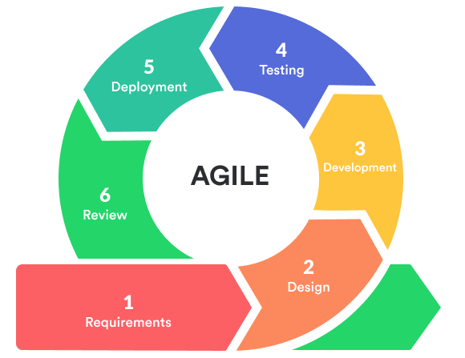
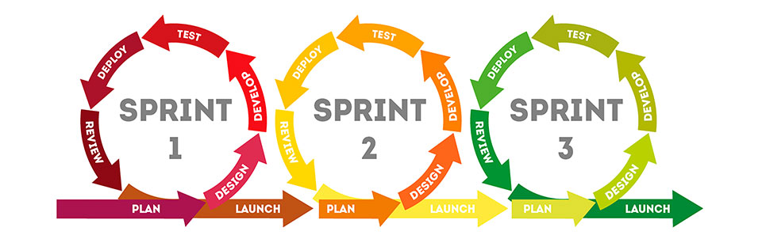

Slide 13
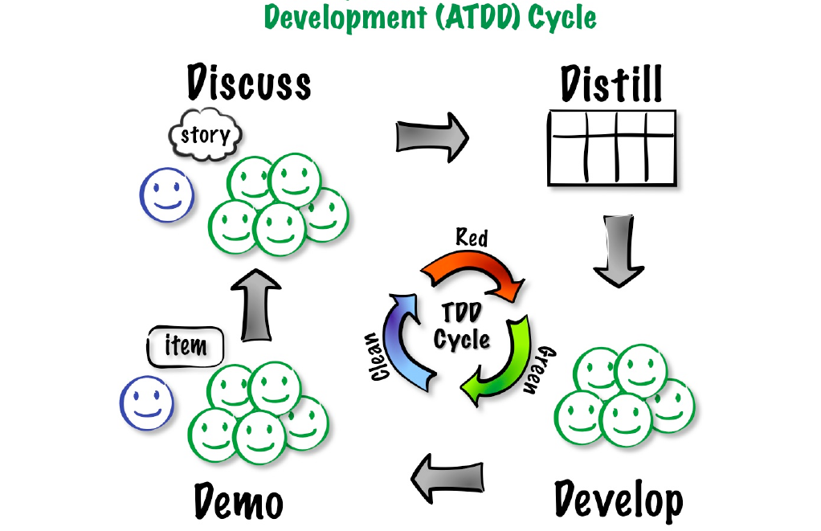
Acceptance Test-Driven Development (ATDD) Cycle

Slide 14
TDD FDD BDD
Python | Django | Selenium

Slide 15
TDD is a design technique for programmers based on unit test first.
BDD is a specification technique based on user stories and test scenarios.
FDD is a development methodology based on object model, feature list, dynamic feature teams, and milestones.

Slide 16
Pitfalls of TDD
Python | Django | Selenium

Slide 17

“The liar”
Passes all test without useful assertions.
(Gives the illusion of coverage and completion)

Slide 18
“Excessive setup”
Requires a lot of time and work to be ready to test.
(This usually happens when code has been written first before the test. Here, the test follows the code.)

Slide 19
“the giant”
Excessive lines of test code and excessive assertions in a single test method.
(Difficult to understand. May contain tests that doesn’t really define what we specifically NEED to test.)

Slide 20
“the mockery”
Uses so many mocks that the REAL code isn’t really tested.
(Using sample values that are only convenient on testing but not really adaptable in production.)

Slide 21
“the inspector”
Violating the encapsulation in order to make assertions.
(we should make full real use of classes in assertions and not just supply values.)
(did you use methods that are only existing in the test but not in the actual production code?)

Slide 22

Title:
SELENIUM
https://selenium.dev

Slide 23
“SELENIUM AUTOMATE BROWSERS”
- selenium.dev

Slide 24

Title
Test Automation
Web Administration Tasks
Enables testers to write test cases that automates browser activities.
Provides access to browser components such as address bar, navigation, etc.
Provides access to web elements in the web application so we can get and check contents.
Provides access to web element control actions like sending input characters, clicking and submitting.
Repetitive web administration tasks can be “recorded” and “automated”
Can be implemented to web sites regardless of programming language and technology used.
Performs actual user behavior like navigating, entering input characters, clicking buttons and links, and submitting forms.

Slide 25
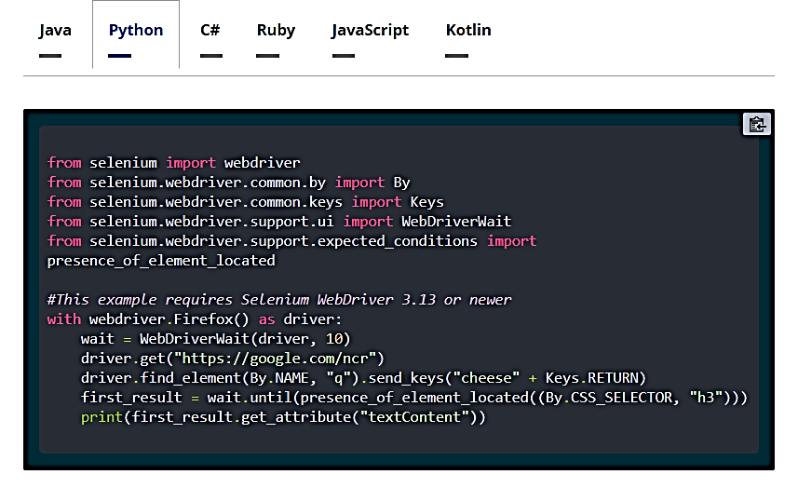
Selenium Tests can be written in a variety of programming languages such as:

Slide 26
Title:
SELENIUM PYTHON
WebDriver Methods

Slide 27
get() – This command is used for launching an application.
current_url() – This command is used to fetch the URL of the application currently opened in the
browser.
title () – This command is used to fetch the title of the application which is currently opened in
the browser.
back() – This method is used to navigate back to the previously visited page and works only if we
moved from one page to another page.
forward () – This method is used to navigate forward from a previously visited page and works only if
back() is used prior to its used.
refresh () – This method is used to reload the existing page and refreshes it.
maximize_window () – This method is used to maximize the window of an existing page.
minimize_window () – This method is used to minimize the window of the existing page.
close () – This method is used to close the window in focus.
quit () – This method is used to close all the windows opened.

Slide 28
Title:
SELENIUM PYTHON
Selectors

Slide 29
SELECTOR METHOD
Name find_element_by_name (“software”)
ID find_element_by_id (“test”)
Class Name find_element_by_class_name (“test-auto”)
Tag Name find_element_by_tag_name (“input”)
Link Text find_element_by_link_text (“Selenium Python”)
Partial Link Text find_element_by_partial_link_text (“Selenium”)
CSS find_element_by_css_selector (“input#txt”)
XPATH find_element_by_xpath (“//a [@alt=’title’]”)

Slide 30
Title:
SELENIUM PYTHON
Web Element Methods and Properties

Slide 31
send_keys()
This is a method that is used to input text in an edit box, text area, and fields inside the form
click()
This is a method that is used to click on a link or button.
clear()
This is a method that is used to clear the text from an edit box or a text area.
submit()
This is a method that can be used with any element within the form tag.
text
This is used to fetch the inner text of an element.
get_attribute()
This method is used to get the attribute or property value of an element.
value_of_css_property ()
This method is used to get the value of the CSS property of the element.

Slide 32
is_displayed()
This method is used to check if the web element is displayed on the page or not.
is_enabled()
This method is used to check if the web element is enabled or not.
is_selected ()
This method is used to check if the web element is selected or not.
location
This method is used to get the web element location in terms of x and y coordinates.

Slide 33
Title:
SELENIUM PYTHON
ASSERTIONS

Slide 34
Note: all examples are passing tests
assertEqual ("Selenium Python", "Selenium Python", "Comparison Done")
assertNotEqual ("Selenium", "Selenium Python", "Comparison Done")
assertTrue ( "2 > 1", "Comparison Done")
assertFalse ( "1 > 2", "Comparison Done")
assertIs ("Selenium Python", "Selenium Python", "Comparison Done")
assertIsNot ("Selenium Python", "Selenium", "Comparison Done")
assertIsNone ( r , "Comparison Done")
assertIsNotNone ( r , "Comparison Done")
j = set(["Python", "Java", "C"])
assertIn ("Python", j , " Comparison Done")
j = set(["Python", "Java", "C"])
assertIn ("UFT", j , " Comparison Done")

Slide 35
Note: all examples are passing tests
browser = webdriver.Chrome (executable_path="C:\\chromedriver.exe")
browser.get ("https://www.softwaretestingmaterial.com")
assertIsInstance (browser, webdriver, " Comparison Done")
browser = webdriver.Chrome (executable_path="C:\\chromedriver.exe")
browser.get ("https://www.softwaretestingmaterial.com")
assertNotIsInstance (driver, webdriver, " Comparison Done")
assertListEqual ([1,3], [1,3], “Comparison Done”)
assertTupleEqual ((4,5), (4,5), “Comparison Done”)
assertDictEqual ({1:4, 2:5}, {1:4, 2:5}, “Comparison Done”)
assertAlmostEqual (0.2,0.21)
assertNotAlmostEqual (0.2,0.3)
assertGreater ( 3, 2, "Comparison Done")
assertGreaterEqual ( 3, 2, "Comparison Done")

Slide 36
Note: all examples are passing tests
assertLess ( 3, 5, "Comparison Done")
assertLessEqual ( 3, 5, "Comparison Done")
assertRegexpMatches ("Selenium Python", "Selenium", "Search Done")
assertNotRegexpMatches ("Pyton Test", "Python", "Search Done")

Slide 37
End of TDD Slides part 1
Next: More of Selenium Python

